Slide 1
RMS Program Screenshots

Slide 2
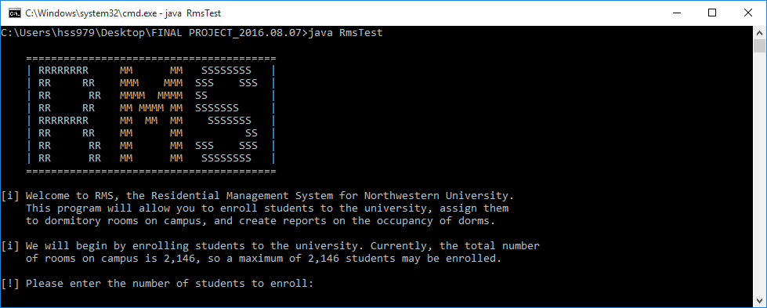
Introduction – Enroll Students
The Intro will display a brief explanation of the program and prompt for number of students to enroll.

Slide 3
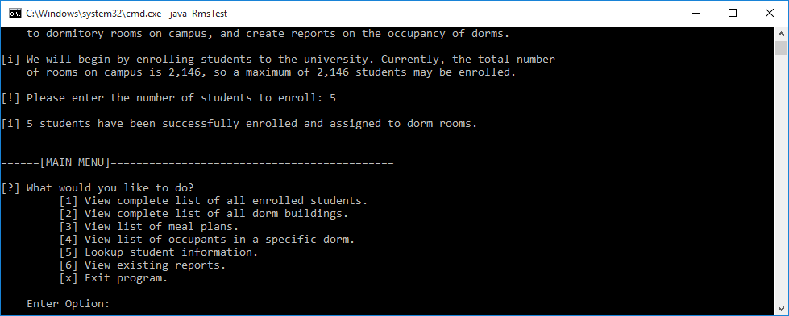
Main Menu
5 students were enrolled. The Main Menu is displayed.

Slide 4
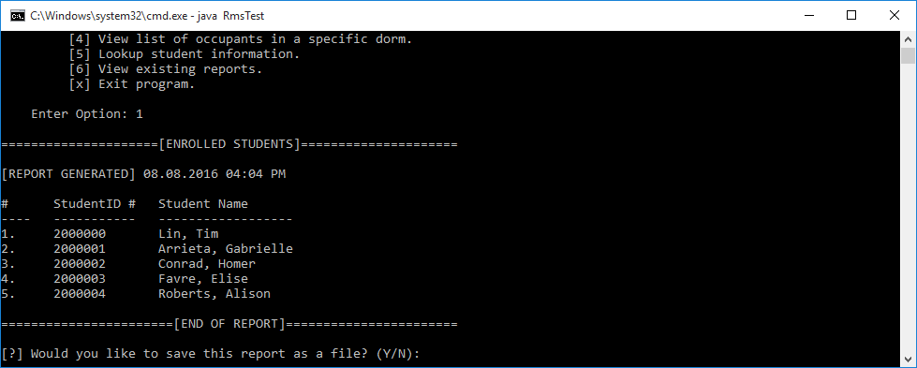
Option 1 – View List of All Enrolled Students
Option 1 selected. Generates report of all enrolled students. Prompts to save report as file.

Slide 5
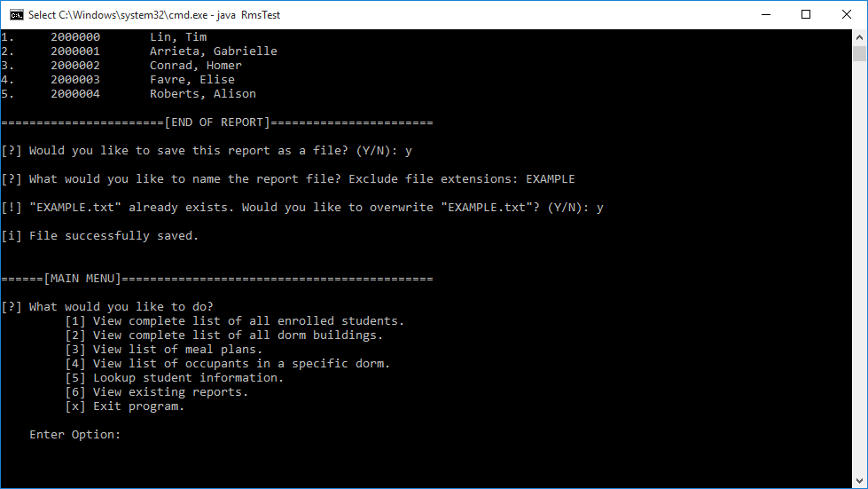
Option 1 report saved as “EXAMPLE.txt”. Had to overwrite existing “EXAMPLE.txt” file. Returns back to Main Menu.

Slide 6
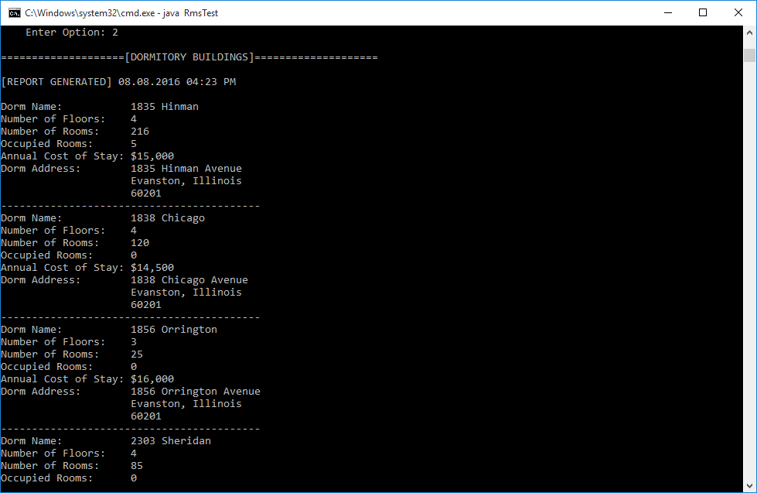
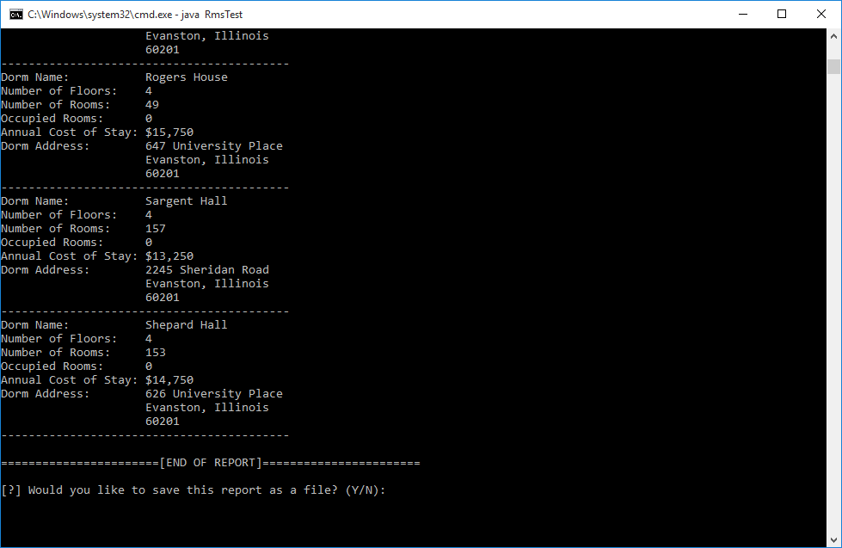
Option 2 – View List of All Dorm Buildings
Option 2 selected. Generates report of all 14 dorm buildings and their information. Prompts to save report as file. Returns back to Main Menu.

Slide 7
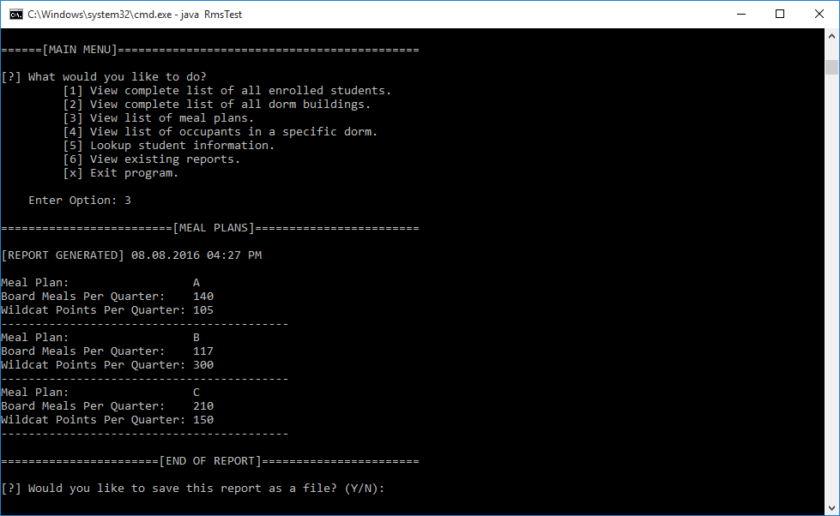
Option 3 – View List of Meal Plans
Option 3 selected. Report generates list of information for all 3 meal plans. Prompts to save report as file. Returns back to Main Menu.

Slide 8
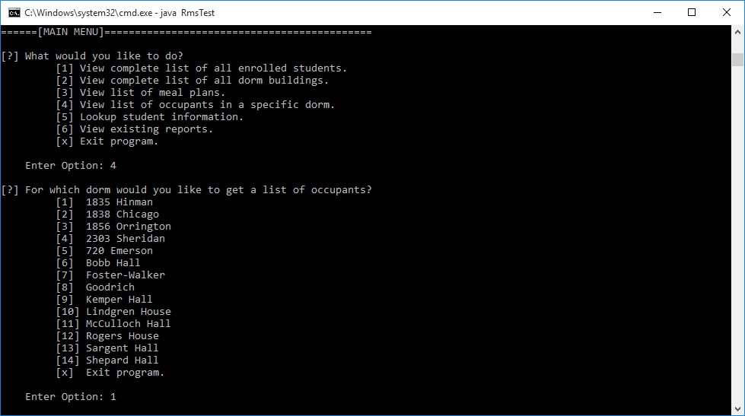
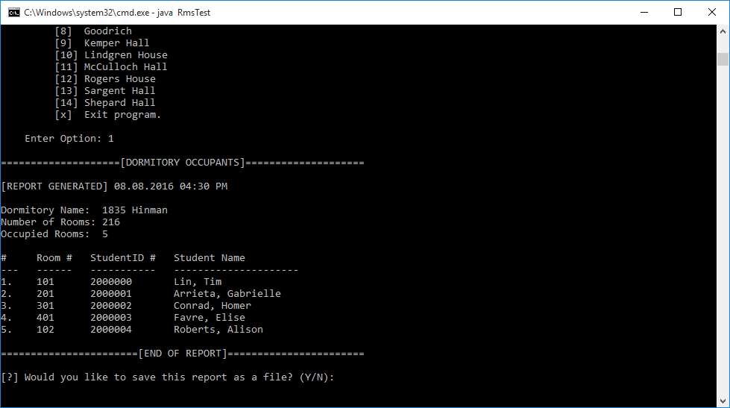
Option 4 – View List of Occupants in Dorm
Option 4 selected. Asks which dorm report should be generated for. Option 1 (1835 Hinman) selected. Generates report for 1835 Hinman. Prompts to save report as file. Returns back to Main Menu.

Slide 9
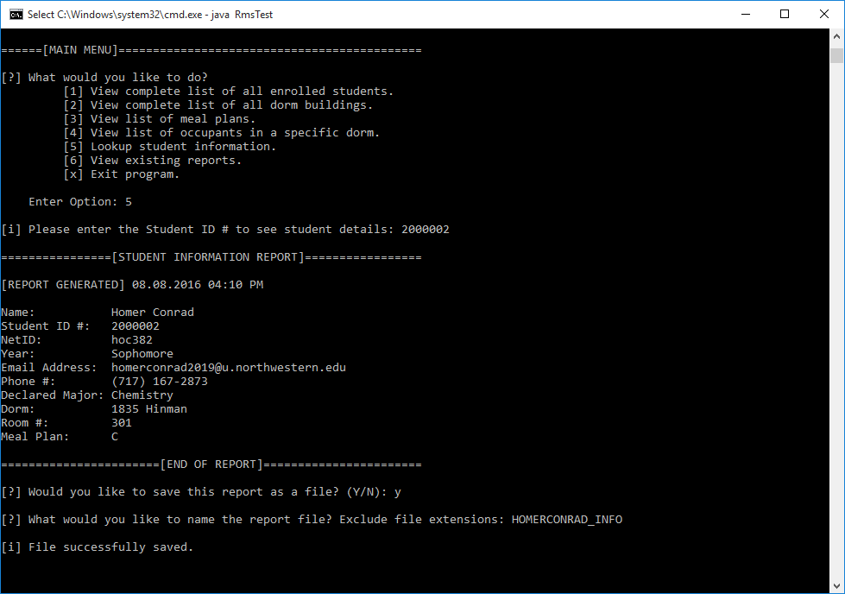
Option 5 – Lookup Student Information
Option 5 selected. Prompts for Student ID #. Generates report for selected student information. Prompts to save report as file. Returns back to Main Menu.

Slide 10
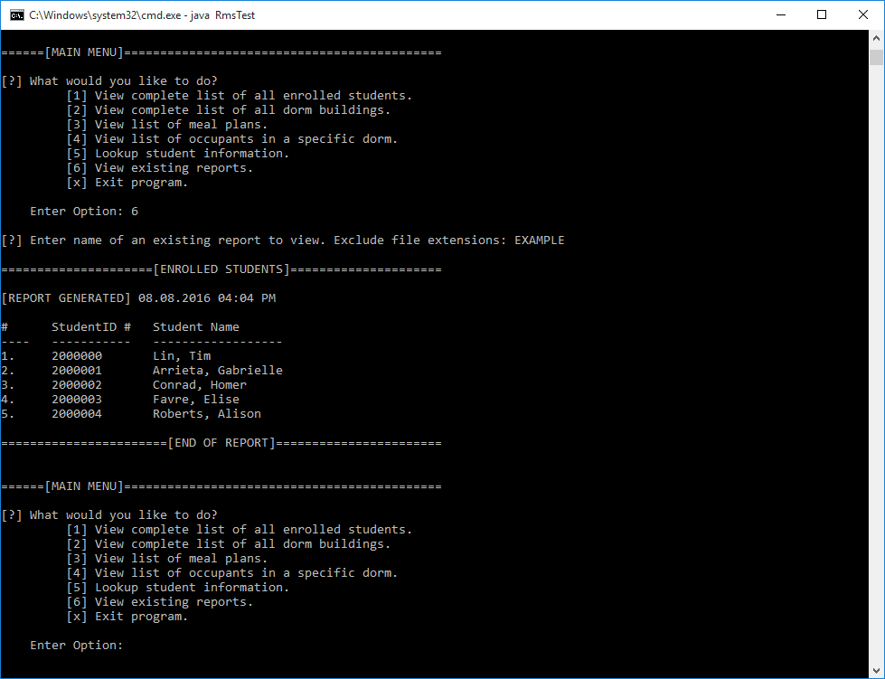
Option 6 – View Existing Reports
Option 6 selected to view “EXAMPLE.txt” created in the Option 1 slide example. Displays contents of the report file. Returns back to Main Menu.

